Slide 1

SecTalks SYD0x25 (38th) - Wireless Client Side Attacks
Edward Farrell Mercury ISS
Sectalks Sydney

Slide 2
Overview
1. an overview of the talk
2. An intro into wireless & wireless security
3. Wireless attacks
4. Setups for attacks
5. This evenings challenges

Slide 3

Slides here

Slide 4

Edward Farrell
Director, Mercury ISS
Pentester for 10 years
Running Mercury since January 2015
Teaching wireless security @ADFA

Slide 5
Preamble
Load Kali (let us know if you need a copy)
Install the mana toolkit, nm-connection-editor & responder sudo apt-get install mana-toolkit nm-connection-editor git clone https://github.com/SpiderLabs/Responder
During the demo there’ll be a heap of traffic. To deconflict, only transmit when your laptop is on the “pad”

Slide 6
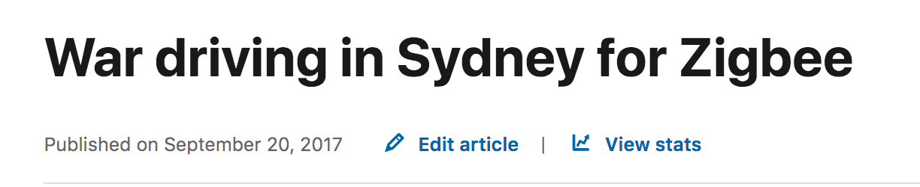
What’s driven this talk?
Everyone keeps thinking wireless in the context of client/server & crypto
There's “2-way” attack surface that we’re paying off.
People make honest mistakes, thinking that tools do everything (sorry Chad)

Slide 7
A short intro to wireless & wireless security concepts

Slide 8
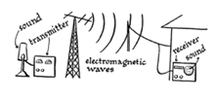
Definition of wireless
Wireless communication is any form of communication transfer between two points that are not physically connected.

Slide 9
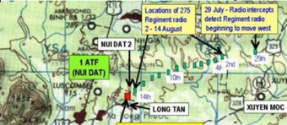
Wireless attacks
Capture
Direction find
Replay
Impersonate
Deny

Slide 10

802.11 standard (wifi)
Developed by CSIRO
Introduced in 1997
designed to allow interconnection of computers and small devices.
Can either be a network or an ad hoc network

Slide 11
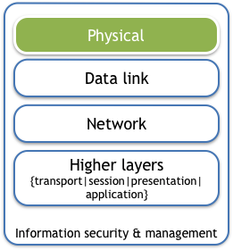
802.11 standard (physical)
Physics
Power
Direction
Location & Environment
Issues
Accessibility
Discoverability and accessibility (part of standard)

Slide 12
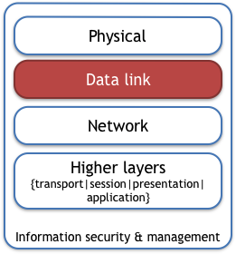
802.11 standard (data link layer)
Sets out the standard for how data is organised/transmitted
Control frames
Data frames
Management frames
Authentication and access control to the network managed at L2
Issues
Access control/limitations
Authenticity/integrity of clients & APs

Slide 13
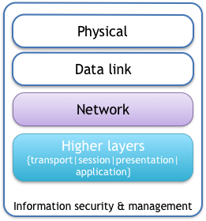
802.11 standard (other parts)
network/layer 3
Typically ties in with the remainder of the IP stack & business excellence
Issues
All the other pre-existing concerns/issues with the higher layers
Variations in use/employment

Slide 14
What attacks can we do

Slide 15
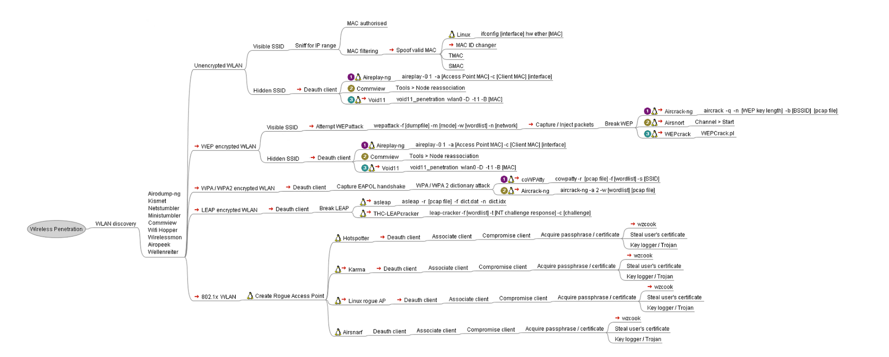
Existing attack methodology

Slide 16
Attacks we don’t always consider
MITM
Passive (open networks, or encrypted networks where you’ve captured the handshake)
When you don't have keys or line of site- ARP poisoning
What can we deduce from encrypted packets?
DoS
Deauthentication as DoS aireplay-ng command
Layer 1 DoS (bypassesses IDS/IPS) Demonstration using HackRF during scenarios

Slide 17
Attacks we don’t always consider
Attacks against clients
APIs on IOT kit are always fun
Clients connect to rogue access points can be vulnerable to all sorts of fantastic issues
This does not fit neatly into your “give me an IP address count” pentesting business excellence methodology BS
Rogue access points
Devices are constantly polling for networks they’ve connected to previously
Can we coerce a connection?

Slide 18

Coercing a connection (rogue APs)
Network | Success | Comments
Open
WEP | meh | Need PW
WPA/WPA2 (PSK) | meh | Need PW
WPA/WPA2 (MGT) | yeah~ | Clients need to be setup to validate AP cert (android sucks at this)
802.11ac | Probably not | Haven’t been playing enough in this space yet (like IPv6)

Slide 19
Setups for attack

Slide 20
Remember
This is about engineering the connection- not about 1337ness
F%$KING Troubleshoot!

Slide 21
mana toolkit
similar concept to pineapples, just doesn’t have a UI or physical hardware to pose with for your instagram
Components
- Karma: the AP will respond to probes
- tie in with security infrastructure (WPA2, EAP-TLS & PEAP)
- Autocrack (MSCHAPv2)
- MITM attack
- SSL Strip
- FireLamb
- Malicious iOS profiles
- Captive Portal (social Engineering)
Also uses Metasploit- written into scripts to fire up Metasploit
Internal network tools

Slide 22
nm-connection-editor
Allows you to create a hotspot in kali- a little easier
In termial, type nm-connection-editor
Click ‘+’
Add a wifi conection, selecting mode as “hotspot”
Add your security settings

Slide 23
Other tools
You have kali & thus all the standard tools
ettercap
metasploit
nmap
wireshark

Slide 24
Your challenges for this evening

Slide 25

Scenario 1- Attack a vulnerable home security system
Create an open network called “internets”
Find the system
Interact with the device using the following cURL request:
curl -i -s -k -X $'POST' \
-H $'Host: 10.42.0.171' -H $'Content-Type: application/json' -H $'Connection: keep-alive' -H $'Accept: application/json' -H $'User-Agent: PsnCpbdSwdgHomenetwork/95 CFNetwork/897.15 Darwin/17.5.0' -H $'Content-Length: 79' -H $'Accept-Language: en-us' -H $'Accept-Encoding: gzip, deflate' \
--data-binary $'sipnum=4bda8d42e82a&request={\"request\":202,\"inHouse\":true,\"data\":{\"armMode\":2}}' \
$'http://10.42.0.171/cgi-bin/devm_request.cgi'

Slide 26
Scenario 2- Attacking a poorly hardened windows client
Create a rogue access point targeting the client beaconing out to the open network ‘sectalks2’
Extract and crack the LANMAN hash using responder
The key is the password

Slide 27
Scenario 3- MITM on a linux client
Create a rogue access point targeting the client beaconing out to ‘sectalks3’
Capture and retrieve the flag from the client
(hint, this may require you to engineer an outbound connection or a dhcp server, your choice)
flag: API Key

Slide 28
Scenario 4- Attacking a vulnerable client
Create an open access point called ‘sectalks4’
Hunt for a vulnerability in the client
Find the key

Slide 29
Scenario 5- WPA2 enterprise rogue AP
Identify clients connecting to “sectalks5”
Modify the following settings in /etc/mana-toolkit/hostapd-mana-eap.conf 1st SSID value to the open network you identify 2nd SSID value to sectalks1_enterprises enable_mana=0 (if this is not set its borderline criminal)
Run the start-noupstream-eap.sh script
Now, find a way to get the flag out of the windows machine :p

Slide 30
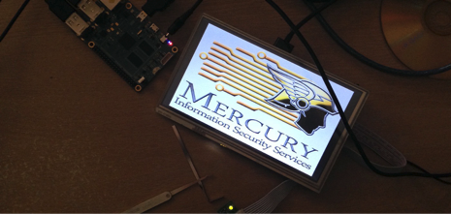

Questions?
E: info@mercuryiss.com.au

